Slide 1

Bottom-up Approach
V2G-Sim Model Architecture
Includes libraries of models of varying complexity & computing time
Core objective: a platform to develop and test any user-defined charge/discharge control approach and co-simulate with complementary models (e.g. distribution, transmission, market, etc.)
V2G-Sim models the driving and charging of many individual vehicles to temporally and spatially predict how vehicles can benefit the electricity grid and how the grid
affects vehicles
e⁻
$

Slide 2
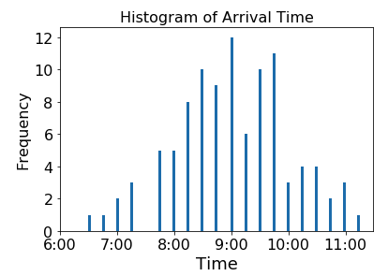
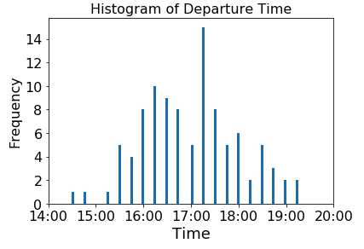
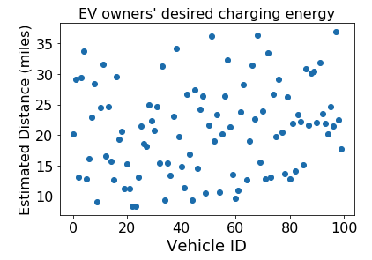
Case study: Energy cost saving + demand charge mitigation
Real-world commercial building load (6/1/2016 – 6/30/2016)
100 EV travel data from CEC-LBNL Alameda County demonstration project
100 * 6.6kW chargers
PG&E E-19 tariff（Medium general demand-metered TOU service) ^{[1]}
Building manager aims to minimize monthly electricity bill (energy cost + demand charges) , without compromising energy demand from EV owners
1. https://www.pge.com/tariffs/tm2/pdf/ELEC_SCHEDS_E-19.pdf

Slide 3
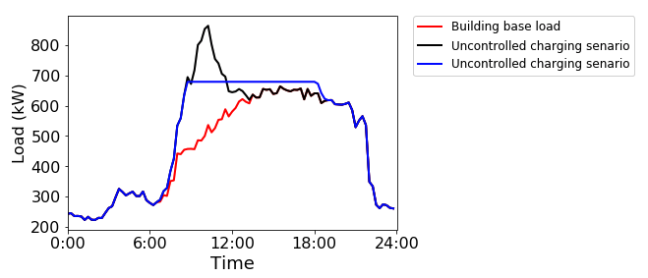
Simulation Results:
Load profiles on the peak day
Assuming stationary battery storage is used to achieve the same effects, the battery should be 243kWh and 185kW.
Based on tesla powerpack price^{[1]}, the capital cost will be : $96,741
Table 1. Monthly electricity bills in different scenarios
Scenarios | Energy charge | Demand charge | total
Base load | 80479.5 | 28376.5 | 108856.0
Uncontrolled charging | 87493.7 | 36926.6 | 124420.3
Controlled charging | 87642.6 | 29015.8 | 116658.4
1. Lambert, Fred (31 October 2016). "Tesla Powerwall 2 has no competition – comparison with LG Resu and SonnenBatterie". Electrek. Retrieved 1 November 2016.

